Slide 1
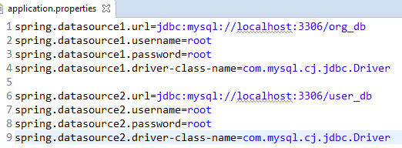
Spring Boot JDBC + MySQL – How to Configure Multiple DataSource?
Org_DB
Employee
Employee Insert
Employee Insert
SpringBoot Application
User Insert
User Insert
User_DB
User

